Slide 1
Shallow Neural Networks
Itay Hazan

Slide 2





A Single Neuron
$$x_{1}$$
$$x_{2}$$
$$a$$
$$⋮$$
$$x_{n}$$

Slide 3

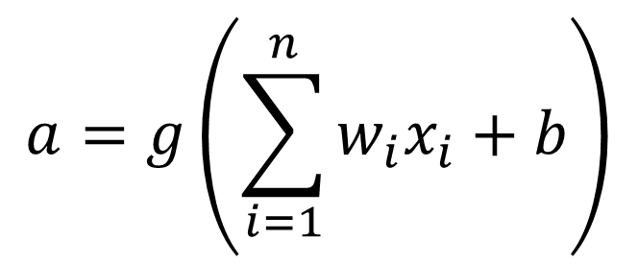
A Single Neuron
$$x_{1}$$
$$a=g\left(\sum_{i=1}^{n}{w_{i}x_{i}}+b\right)$$
$$x_{2}$$
$$w_{1},…,w_{n} \\ b$$
$$⋮$$
$$x_{n}$$

Slide 4
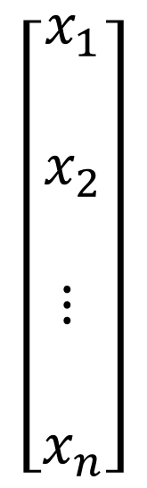
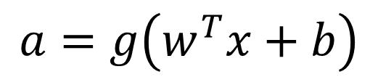

A Single Neuron
$$\left[\begin{matrix}x_{1} \\ \\ x_{2} \\ \\ ⋮ \\ \\ x_{n}\end{matrix}\right]$$
$$w∈ℝ^{n} \\ b∈ℝ$$
$$a=g\left(w^{T}x+b\right)$$
$$⋮$$

Slide 5

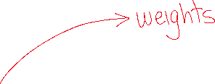

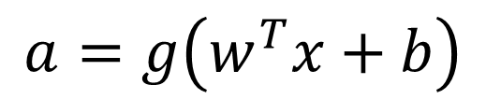


A Single Neuron
$$\left[\begin{matrix}x_{1} \\ \\ x_{2} \\ \\ ⋮ \\ \\ x_{n}\end{matrix}\right]$$
$$w∈ℝ^{n} \\ b∈ℝ$$
$$a=g\left(w^{T}x+b\right)$$
$$⋮$$

Slide 6
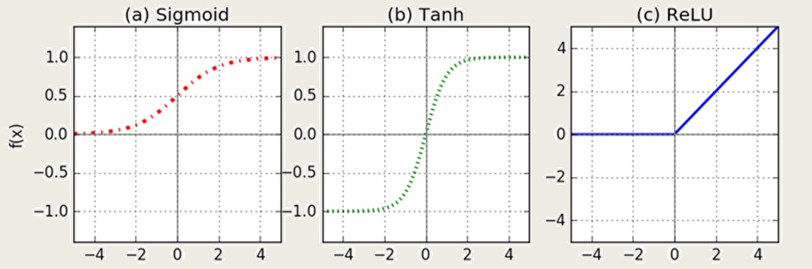
Common Activation Functions

Slide 7
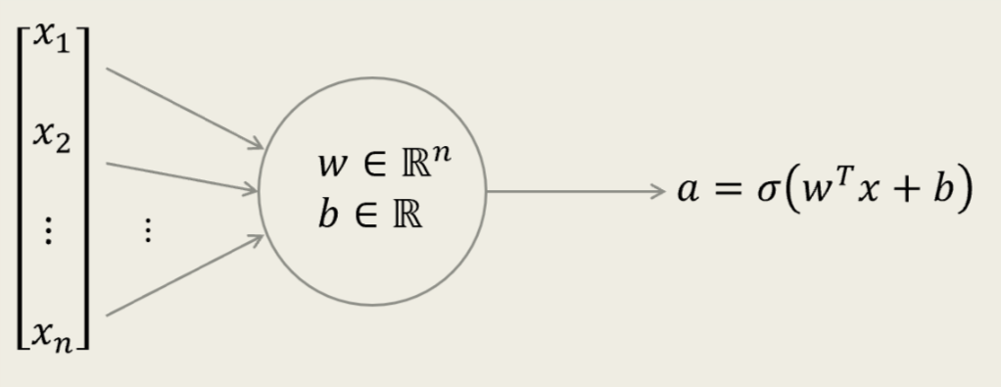
































Logistic Regression with a Single Neuron

Slide 8
A Fully-Connected (Dense) Neural Network with One Hidden Layer
$$x_{1}$$
$$x_{2}$$
$$\hat{y}$$
$$x_{3}$$

Slide 9






A Fully-Connected (Dense) Neural Network with One Hidden Layer
$$x_{1}$$
$$x_{2}$$
$$\hat{y}$$
$$x_{3}$$

Slide 10
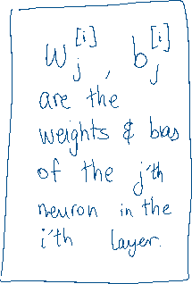
A Fully-Connected (Dense) Neural Network with One Hidden Layer
$$x_{1}$$
$$x_{2}$$
$$\hat{y}$$
$$x_{3}$$

Slide 11

A Fully-Connected (Dense) Neural Network with One Hidden Layer
$$x_{1}$$
$$x_{2}$$
$$\hat{y}$$
$$x_{3}$$

Slide 12



A Fully-Connected (Dense) Neural Network with One Hidden Layer
$$x_{1}$$
$$x_{2}$$
$$\hat{y}$$
$$x_{3}$$

Slide 13
Feed-Forward Algorithm
$$x_{1}$$
$$x_{2}$$
$$\hat{y}$$
$$x_{3}$$

Slide 14
Feed-Forward Algorithm
$$x_{1}$$
$$x_{2}$$
$$\hat{y}$$
$$x_{3}$$

Slide 15
Feed-Forward Algorithm
$$x_{1}$$
$$x_{2}$$
$$\hat{y}$$
$$x_{3}$$

Slide 16

Feed-Forward Algorithm
$$x_{1}$$
$$x_{2}$$
$$\hat{y}$$
$$x_{3}$$

Slide 17

Feed-Forward Algorithm
$$x_{1}$$
$$x_{2}$$
$$\hat{y}$$
$$x_{3}$$

Slide 18


Feed-Forward Algorithm
$$x_{1}$$
$$x_{2}$$
$$\hat{y}$$
$$x_{3}$$

Slide 19

Feed-Forward Algorithm
$$x_{1}$$
$$x_{2}$$
$$\hat{y}$$
$$x_{3}$$

Slide 20
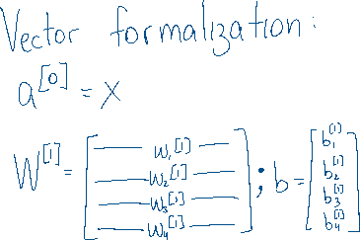
Feed-Forward Algorithm
$$x_{1}$$
$$x_{2}$$
$$\hat{y}$$
$$x_{3}$$

Slide 21
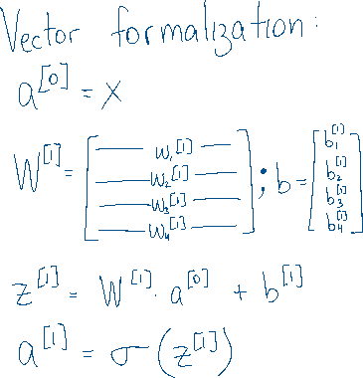
Feed-Forward Algorithm
$$x_{1}$$
$$x_{2}$$
$$\hat{y}$$
$$x_{3}$$

Slide 22


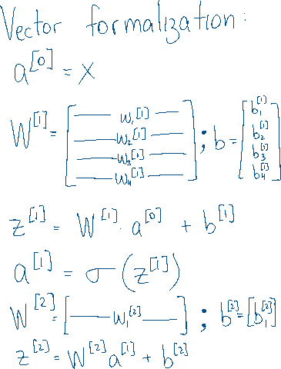
Feed-Forward Algorithm
$$x_{1}$$
$$x_{2}$$
$$\hat{y}$$
$$x_{3}$$

Slide 23
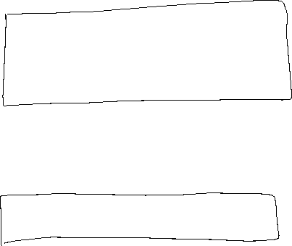
Feed-Forward Algorithm
$$x_{1}$$
$$x_{2}$$
$$\hat{y}$$
$$x_{3}$$

Slide 24
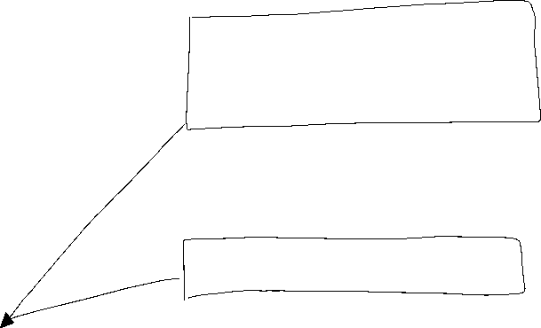
Feed-Forward Algorithm
$$x_{1}$$
$$x_{2}$$
$$\hat{y}$$
$$x_{3}$$

Slide 25
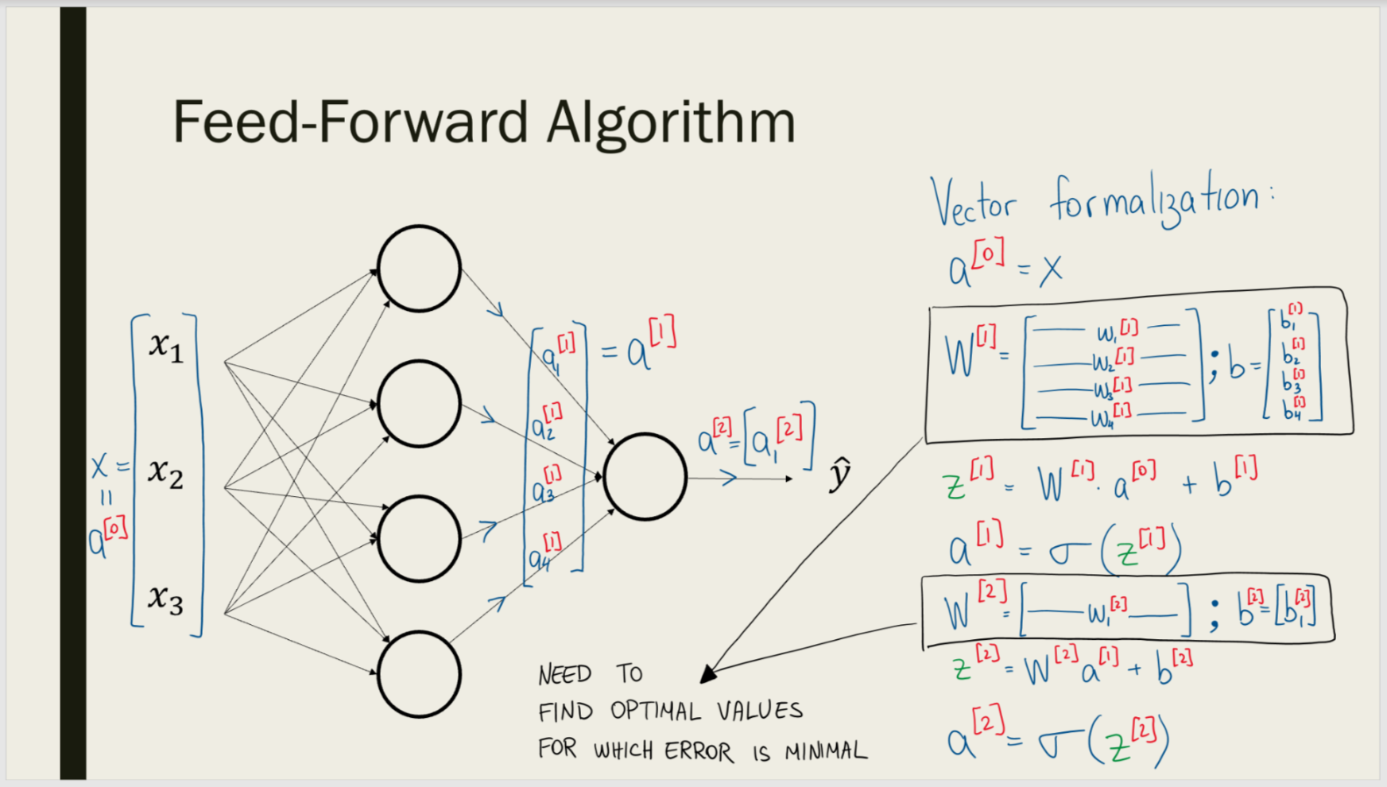
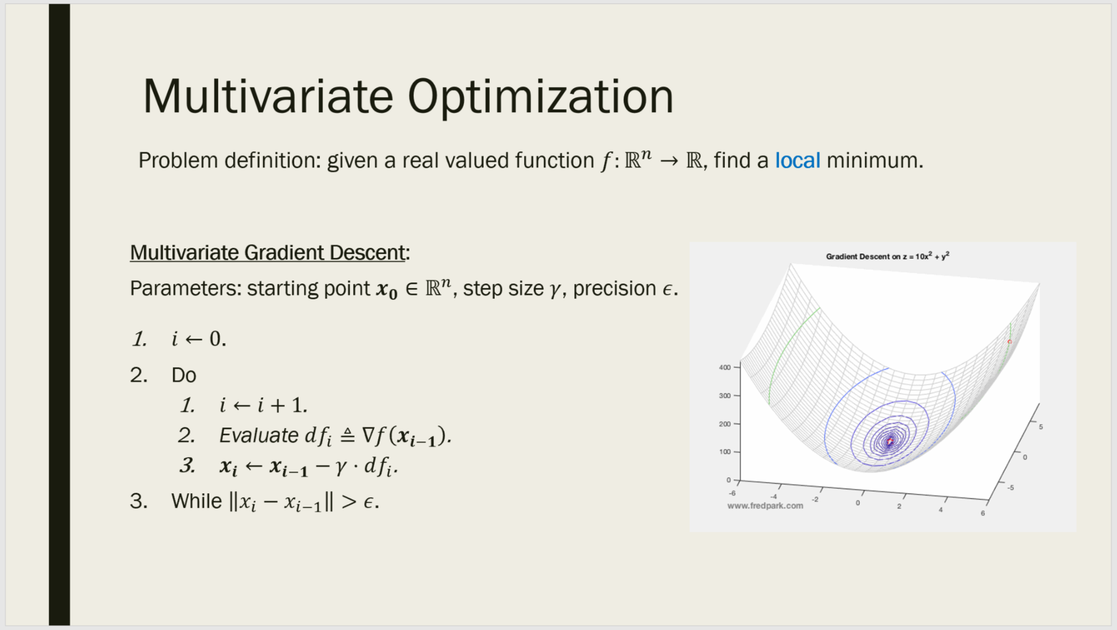
Optimization!

Slide 26



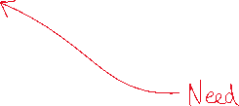
Optimization!

Slide 27
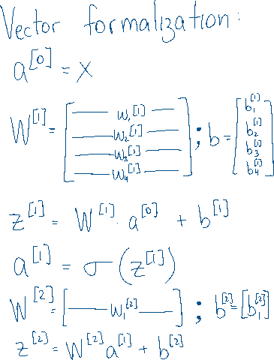


Back Propagation Algorithm for Evaluating the Gradient

Slide 28




Back Propagation Algorithm for Evaluating the Gradient

Slide 29


Back Propagation Algorithm for Evaluating the Gradient

Slide 30






Back Propagation Algorithm for Evaluating the Gradient

Slide 31




Back Propagation Algorithm for Evaluating the Gradient

Slide 32
Back Propagation Algorithm for Evaluating the Gradient

Slide 33




Back Propagation Algorithm for Evaluating the Gradient

Slide 34




Back Propagation Algorithm for Evaluating the Gradient

Slide 35

Back Propagation Algorithm for Evaluating the Gradient

Slide 36


Back Propagation Algorithm for Evaluating the Gradient

Slide 37

Back Propagation Algorithm for Evaluating the Gradient

Slide 38





Back Propagation Algorithm for Evaluating the Gradient

Slide 39
Back Propagation Algorithm for Evaluating the Gradient
$$x_{1}$$
$$x_{2}$$
$$\hat{y}$$
$$x_{3}$$

